Slide 1

IE 534 Deep Dive Project 22 Predict the GPA/grade distribution of UIUC
Zhijie Chen, Hongbo Zheng, Ning Wang
12/11/2024
Notes:
Hi guys, We are group 22 My name is Ning Wang, MY teammates is xxx and xxx. Our project is about predict the GPA distribution of UIUC

Slide 2
Project Motivation
A predictor of GPA can be valuable for:
Students who want to enroll in classes
School administrators to analyze overall grades
Accurate GPA predictions can guide decisions on scholarships, internships, and placement opportunities.
Educators can tailor resource and teaching functions to individual student needs
Deep learning is suitable for analyzing GPA data
Contributor: Ning Wang, Zhijie Chen
Notes:
Deep neural networks excel in capturing complex, non-linear relationships within data, making them ideal for GPA prediction.They can process multiple influencing factors, such as course difficulty, attendance and engagement which traditional methods may overlook.

Slide 3
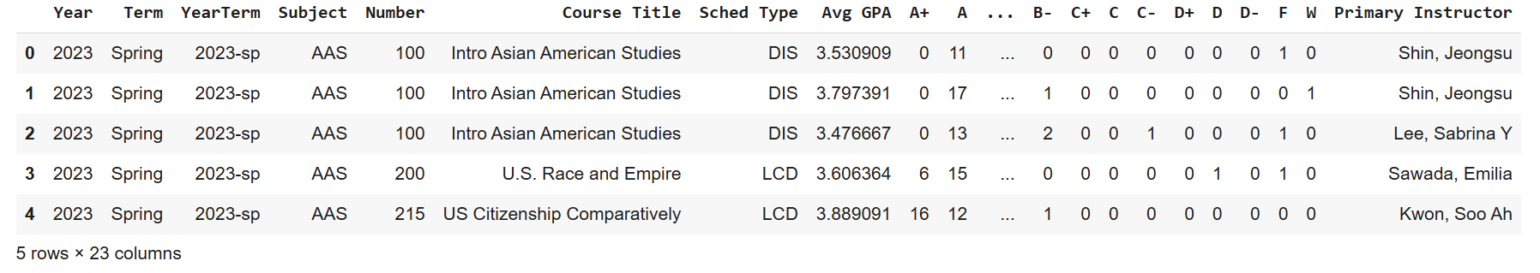
Dataset Overview
Attributes:
Year Term Subject Number Sched_Type Instructor
Label:
Average GPA for MSE and R^2 computation
Converted average GPA to letter grades (A+, A, A-, …) for accuracy computation
Contributor: Hongbo Zheng, Zhijie Chen
Notes:
This slide provides an overview of the dataset used for GPA prediction. The dataset includes various attributes such as Year, Term, Subject, Course Number, Schedule Type, and Primary Instructor, along with detailed course information and performance metrics. The label for prediction is the average GPA, which is used for Mean Squared Error (MSE) and R2R^2R2 computations. Additionally, the average GPA is converted into letter grades (A+, A, A-, etc.) for accuracy evaluation. This comprehensive dataset enables both numerical and categorical analysis, offering a robust foundation for modeling and predicting student performance across courses.

Slide 4
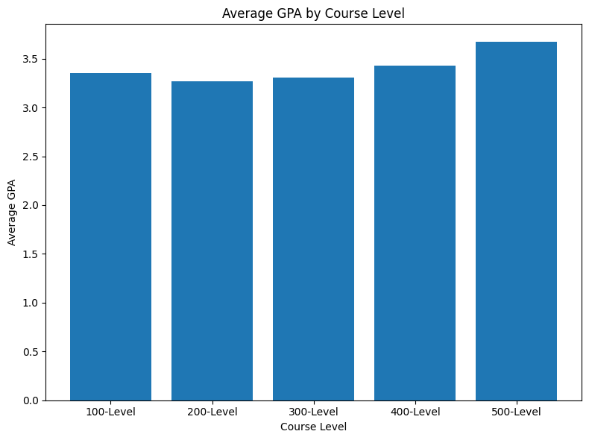
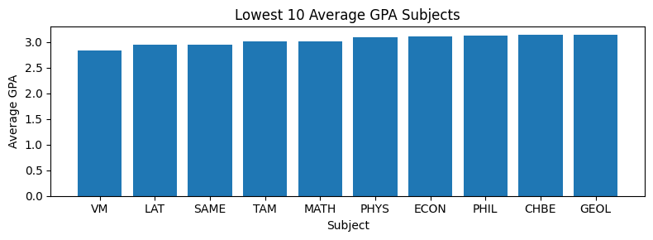
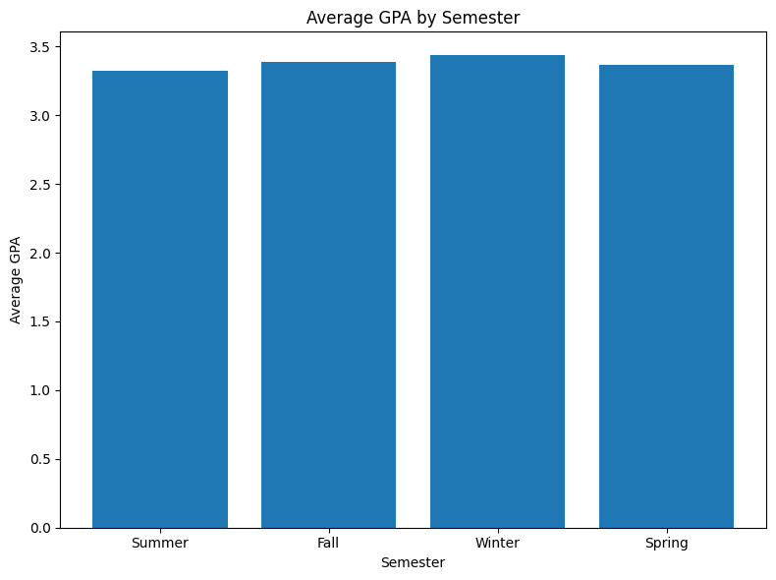
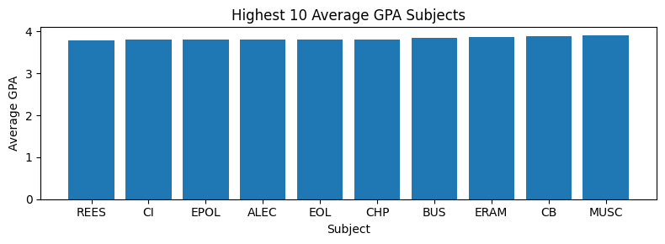
Dataset Statistics
Contributor: Ning Wang, Zhijie Chen
Notes:
, and we plot the average GPA of the courses with the same feature.
For example, on the upper left, we plot the average GPA by course levels. It seems 500-level courses has higher GPA.
We also plot the 10 lowest/highest GPA courses. We do not observe significant effects on the semester.

Slide 5
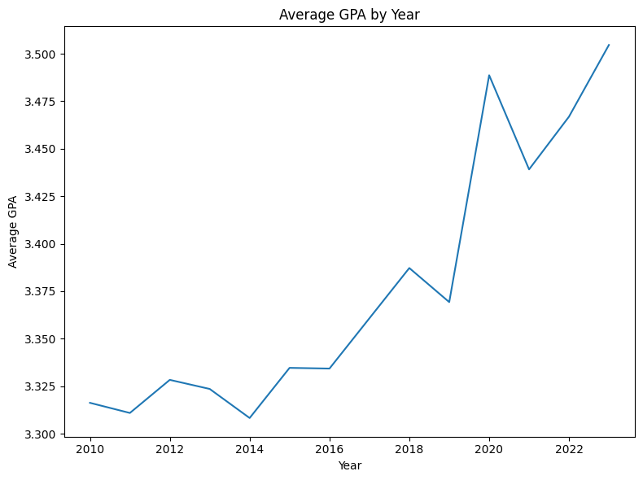
Dataset Statistics
Contributor: Ning Wang, Hongbo Zheng
Notes:
We can see the trend of the average GPA by year is increasing over time. It makes sense to see that 2020 has very high GPA because it’s during COVID period

Slide 6
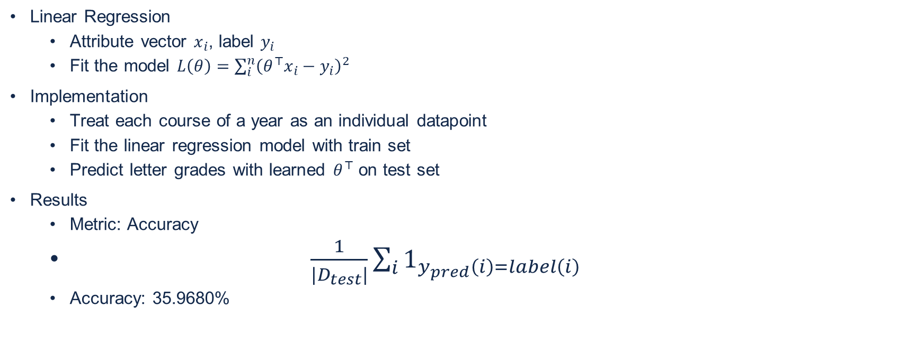
Baseline Model
Contributor: Hongbo Zheng, Zhijie Chen
Notes:
We use the linear regression as a foundational approach. In this model, each course in a given year is treated as an individual data point, with attributes represented by a feature vector xi and the corresponding GPA as the label yi​. The linear regression model is trained by minimizing the mean squared error, on the training set and then evaluated on a test set. The performance metric used is accuracy, based on the proportion of correctly predicted letter grades. The baseline model achieves an accuracy of thirty-six percentage, highlighting the limitations of linear regression in capturing complex relationships in academic data and motivating the use of deep learning for improved performance.

Slide 7
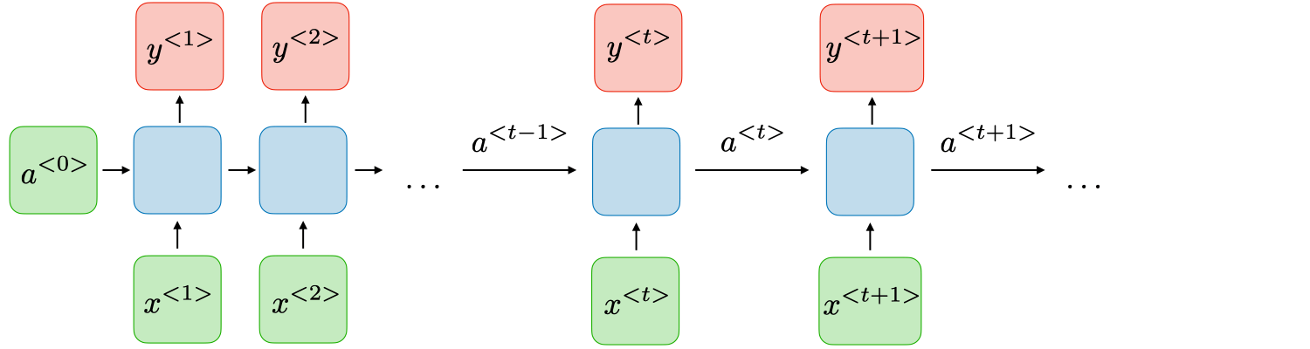
RNN
Consider the temporal dependence
Implementation
Group the data by course names
For each course
Collect chronological data based on the Year/Term attributes
Split each course into a consecutive ~5 years series (10 timesteps)
Treat a series of course records as one datapoint
Train RNN with train set
Predict GPA and letter grade on test set
Results
Metric: same as in the baseline model.
Accuracy: 40.1809%
Perform better than linear regression
Contributor: Hongbo Zheng, Zhijie Chen, Ning Wang
Notes:
This slide introduces the use of Recurrent Neural Networks (RNNs) to do this job, focusing on capturing the temporal dependencies inherent in academic data. The implementation groups data by course names, collects chronological records based on year/term attributes, and segments them into sequences of approximately five years (10 timesteps). Each series of course records is treated as a single data point, and the RNN is trained on this structured dataset. The trained model predicts GPA and letter grades on the test set, using accuracy as the performance metric, similar to the baseline model. The RNN achieves an accuracy of 40.18%, outperforming the linear regression baseline and demonstrating the benefits of modeling temporal patterns in GPA prediction. The technical challenge here is the temporal length of each course is not the same. This may be because some courses are only available in Spring, some are in Fall, and others are in both. So as an additional step of data preprocessing, we align the dataset, where each datapoint has 10 timesteps, and feed them into an RNN model.

Slide 8
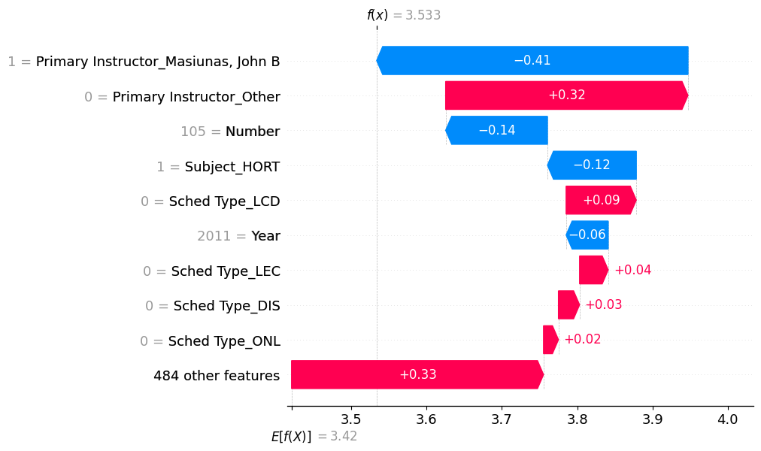
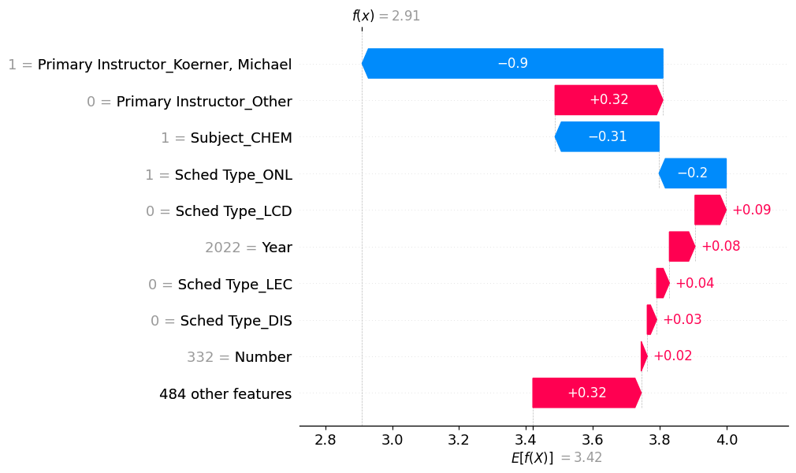
Feature Importance
Compute the SHAP Value[1] to characterize feature importance.
decompose the output of a model by the sums of the impact of each feature
[1] https://shap.readthedocs.io/en/latest/
Contributor: Ning Wang, Zhijie Chen
Notes:
Then we analyze the feature importance of the model. Since our task has multiple attributes, it’s computationally hard to derive the shapley value. As an alternative approach, we utilize the existing python library called SHAP. The SHAP value characterized feature importance by decomposing the output of a model by the sums of the impact of each feature. For example, on the right plot, this is a sample course of CHEM 332 at Year 2022. The model output starts from the expectation value (3.42) at the bottom. The impact of each feature is shown by the bar plots. For example, the Year attribute has a positive 0.08 effect to the final output, and the instructor Koerner, Michael has a negative 0.9 effect. Adding all these effects up will lead to the model output of this course. We can visualize the feature effects in each individual course, and we further want to know the overall effect of each feature on the whole dataset.

Slide 9
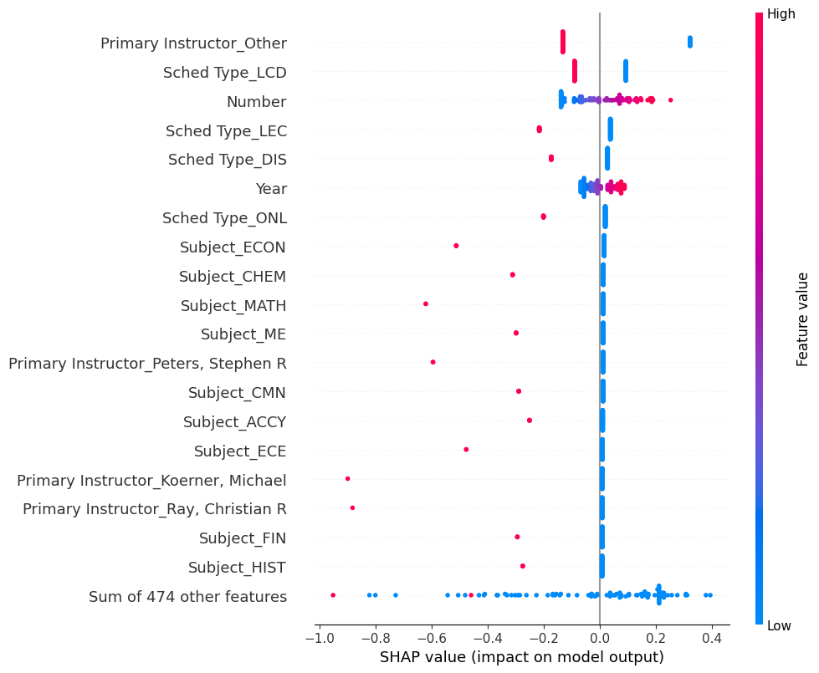
Feature Importance
The average SHAP values on top-20 features.
Contributor: Ning Wang, Hongbo Zheng
Notes:
In this plot, we show such overall effect, and rank the features by their importance. For example, it seems the course Sched Type has significant impacts on the model output. The course number is also important, which validates our observation on 500-level course having higher GPAs. Also, we observe the Year is among the most important features. Several subjects like economic, chemistry, and math have larger effects on the GPA. For a student who wants to get higher GPAs, with this plot, they’d better avoid such courses. For school administrations, this plot can being to their attention on why those courses have abnormal GPA.

Slide 10
Thank you!

